Slide 1
CSC370
Project Overview - Daniel Dubichev

Slide 2
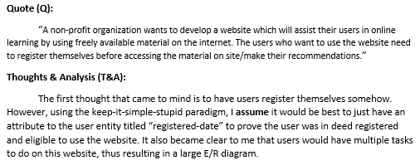
Assignment 1: Project Overview, E/R Diagram
Chose option 2
Requirement Analysis
Quote and answer from the project pdf, with assumptions included
E/R Diagram was formed from initial assumptions
Done Database work on Co-op but….
Never done E/R Diagrams, but realized they are very helpful for orchestrating DB creation

Slide 3
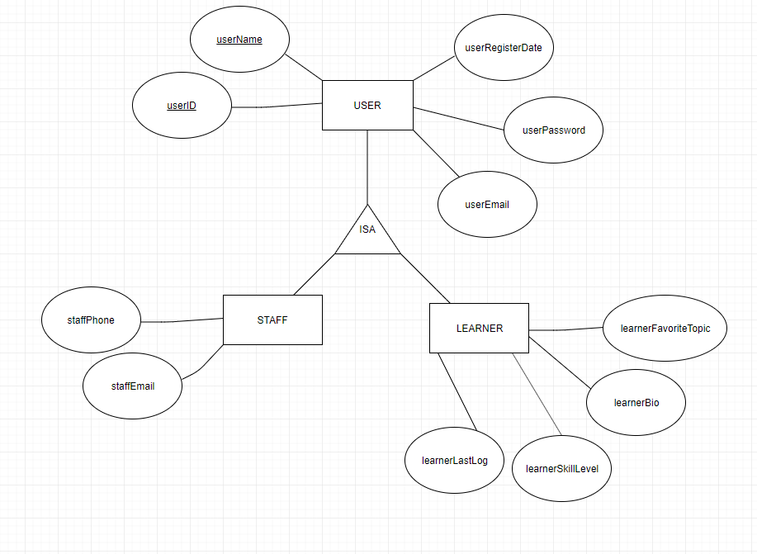
E/R Diagram formed from Req Analysis
Was a step by step process
Started with listing each entity and its attributes, then using keys to relate the entities to each other
Subconsciously implemented normalization in this method, separating entries from sequences to save time and data

Slide 4
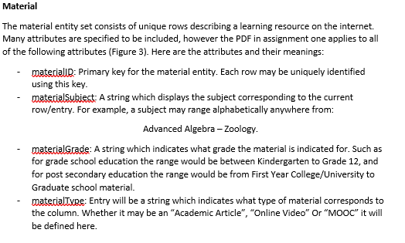
Listed info about attributes while creating entities
Saved time on later project phases by doing this in phase 1

Slide 5
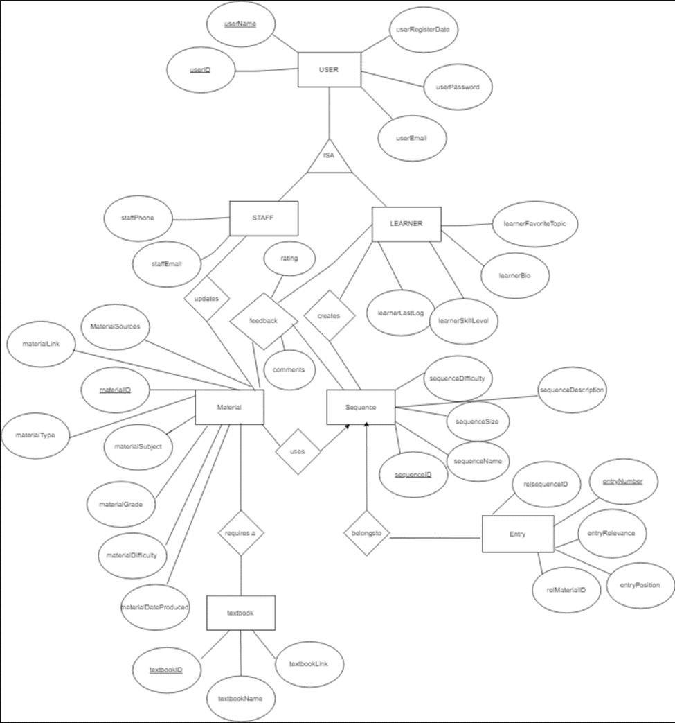
Final E/R Diagram Major Relations: User Staff (rel to user) Learner (rel to user) Material (rel to sequence) Sequence Textbook (rel to material) Entry (rel to material, sequence)

Slide 6
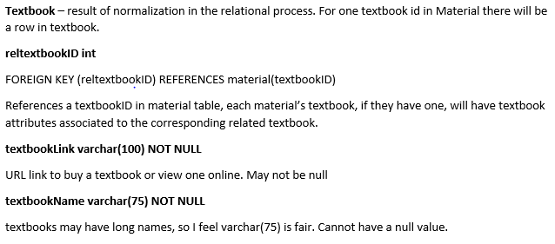
Assignment 2: Relation Defining
Since attributes were already defined in A1, they needed refinement and a different visual display
Took all the entities in A1, made sure they were mapped correctly and belonged to the right schemas, then displayed them in a relational manner

Slide 7
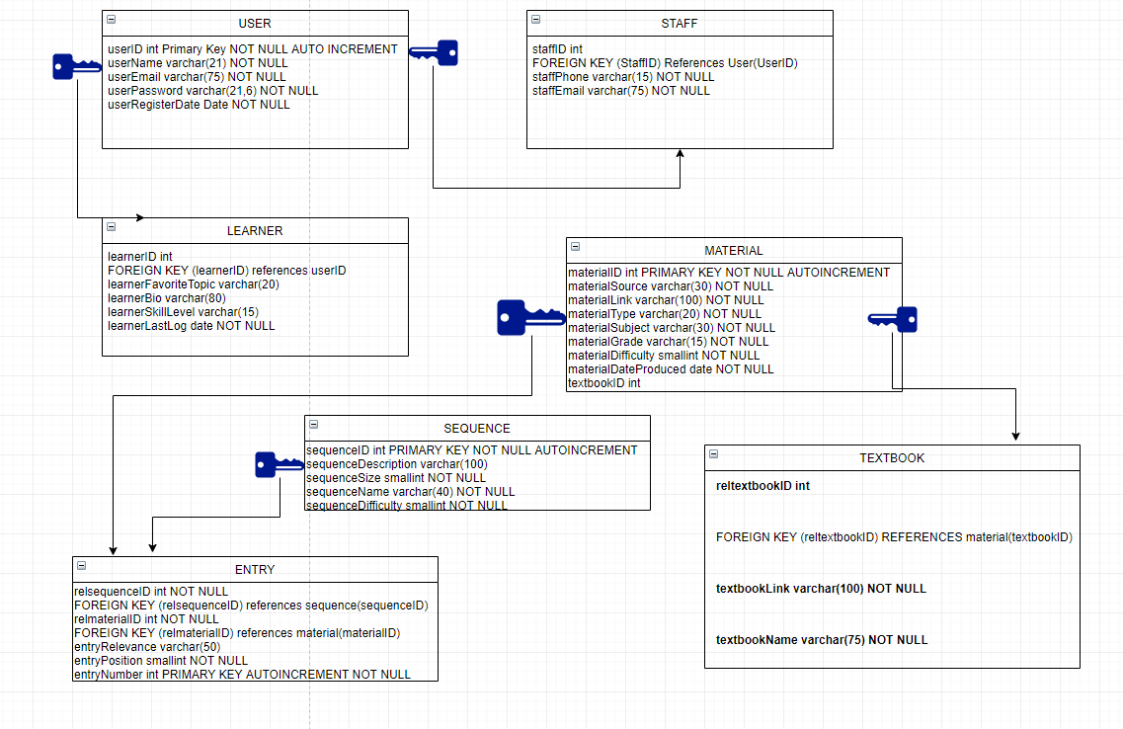
Assignment 2: Final Result

Slide 8
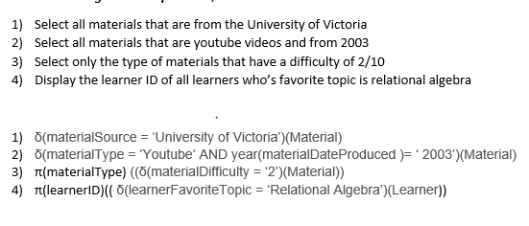
Assignment 2: Relational algebra

Slide 9
Assignment 3: Script
Script demo
Users have an interactive beginning to end experience with the script
Can add, delete, update, insert, truncate tables
‘raw_input’ function used a lot.
Proper error constraints, some data will not enter the database if it is a duplicate username or url pertaining to online material, and more!

Slide 10
Assignment 4: BigQuery
Scenario
I am an investor doing research in the NCAA basketball database. With California recently approving a law NCAA athletes to make money off of endorsements during their university career, investment opportunities and deals are popping up to top level athletes. I will conducting some research on the most successful teams, where success is defined by factors such as championships won, win/loss ratio, popularity and more. As well as personal factors which may lead me to invest in a certain team, like if they are based near California, or their jerseys are my favorite color

Slide 11
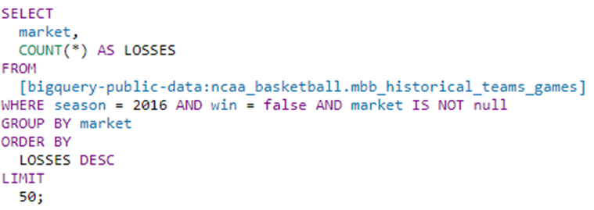
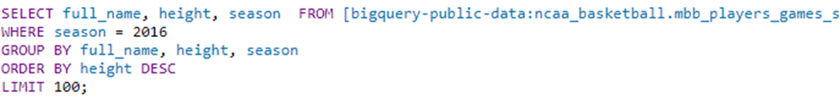
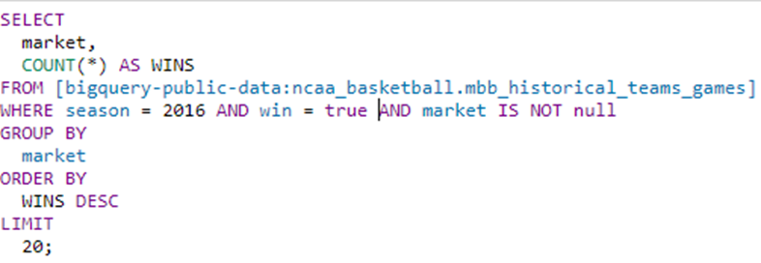
Sample BigQueries
Teams with most losses in
2016 (Teams to not scout / invest)
Tallest player
(Players to scout/ invest in)
Teams with most wins in
2016
(Teams to scout/invest in)

Slide 12

Thank you!

